Slide 1
Journal Club
SLOPER4D: A Scene-Aware Dataset for Global 4D Human Pose Estimation in Urban Environments
ICCV 2023
Yudi Dai (1), Yitai Lin (1), Xiping Lin (2), Chenglu Wen (1), Lan Xu (2), Hongwei Yi (3), Siqi Shen (1), Yuexin Ma (2), Cheng Wang (1)
(1) Xiamen University, China
(2) ShanghaiTech University, China
(3) Max Planck Institute for Intelligent Systems, Germany
Notes:
We present SLOPER4D, a novel scene-aware dataset collected in large urban environments to facilitate the research of global human pose estimation (GHPE) with human-scene interaction in the wild
Employing a head-mounted device integrated with a LiDAR and camera, we record 12 human subjects’ activities over 10 diverse urban scenes from an egocentric view.
Frame-wise annotations for 2D key points, 3D pose parameters, and global translations are provided, together with reconstructed scene point clouds.
To obtain accurate 3D ground truth in such large dynamic scenes, we propose a joint optimization method to fit local SMPL meshes to the scene and fine-tune the camera calibration during dynamic motions frame by frame, resulting in plausible and scene-natural 3D human poses.
Eventually, SLOPER4D consists of 15 sequences of human motions, each of which has a trajectory length of more than 200 meters (up to 1,300 meters) and covers an area of more than 200 m2 (up to 30,000 m2 ), including more than 100k LiDAR frames, 300k video frames, and 500k IMU-based motion frames.
With SLOPER4D, we provide a detailed and thorough analysis of two critical tasks, including camera-based 3D HPE and LiDAR-based 3D HPE in urban environments, and benchmark a new task, GHPE.
To our knowledge, it is the first urban-level 3D HPE dataset with multi-modal capture data, including calibrated and synchronized IMU measurements, LiDAR point clouds, and images for each subject. Moreover, the dataset provides rich annotations, including 3D poses, SMPL [32] models and locations in the world coordinate system, 2D poses and bounding boxes in the image coordinate system, and reconstructed 3D scene mesh.
Our contributions are summarized as follows:
We propose the first large-scale urban-level human pose dataset with multi-modal capture data and rich human-scene annotations.
We propose an effective joint optimization method for acquiring accurate human motions in both local and global by integrating LiDAR SLAM results, IMU poses, and scene constraints.
We benchmark two HPE tasks as well as a GHPE task on SLOPER4D, demonstrating its potential of promoting urban-level 3D HPE research.
Table 1. Comparisons with existing datasets.
Human self-localization aims at estimating the 6-DoF of the human subject in global coordinates.
To achieve self-localization, LiDAR is designed as backpacked [20, 31, 54] and hand-held [2]. To efficiently capture human motions and reconstruct urban scenes, we utilize LiDAR with a built-in IMU (different from the IMUs for motion capture) and propose a pipeline for constructing multi-modal data.
Most studies recover human meshes in camera coordinate [26, 66] or root-relative poses [18, 24, 25].
Regarding the sensor module, the 128-beams Ouster-os1 LiDAR and the DJI-Action2 camera are rigidly installed on the helmet. To capture raw human motions, we use Noitom’s inertial Mo-Cap product, PN Studio, to attach 17 wireless IMUs to the IMU wearer’s body limbs, torso, and head. The camera’s field of view (FOV) is 116°×84° and the LiDAR’s FOV is 360°×45°. To make the performer within the LiDAR’s FOV as much as possible, we tilt the LiDAR down around 45°. Regarding the storage module, the scanning person’s back-pack places a wireless IMU data receiver, a 24V battery, and an Intel NUC11. The mini-computer NUC11 stores IMU data from the wireless receiver and point clouds from Li-DAR in real-time. Videos are stored locally in the camera. The LiDAR and NUC11 are both powered by the battery.
Following the setup in [53], we use a chess-board to calibrate the camera intrinsic Kin and introduces a terrestrial laser scanner (TLS) to obtain accurate camera extrinsic parameter, Kex . Due to the LiDAR point cloud being too sparse, we manually choose the corresponding points both on the 2D image and the TLS map registered to the point cloud, and then we solve the perspective-n-point (PnP) problem to obtain Kin.
The synchronization of data from multiple sensors in human subject data is achieved through peak detection. Before and after the capture, the subject is asked to perform jumps. Then the peak height time in IMU is automatically detected and the peak times in the LiDAR and camera data are manually identified. Finally, all modalities are aligned by the peaks and downsampled to match the Li-DAR frame rate of 20 Hz.
We use Detectron [56] to detect and Deepsort [55] to track humans in videos.
However, due to the jitter brought by dynamic motions, the camera and the Li-DAR are not perfectly rigidly connected.
The LiDAR-only method often fails in mapping because of the dynamic head rotation and crowded urban environments. Incorporating an IMU can compensate for motion distortion in a LiDAR scan pL and provide an accurate initial pose. Using a LiDAR with an integrated IMU, and by combining Kalman filter-based lidar-inertial odometry [58] with factor graph-based loop closure optimization [7] [22], we successfully estimate the ego-motion of LiDAR and build the global consistency 3D scene map with n frame point clouds. To provide accurate scene constrain in Sec. 3.3, we utilize the VDB-Fusion [47] to generate a clean scene mesh S that excludes moving objects.
We use SMPL [32] to representthe human body motion M I = Φ(θI , tI , β) ∈ R6890×3 in IMU coordinate space{I}, where pose parameter ΘI1 = {θ1I , . . . , θnI } ∈ R72×n is composed of pelvis joint’s orientation R1 = {r1I , . . . , rnI } ∈ R and the other 23 joints’ rotation relative to their parent joint. The T1 is the pelvis joint’s translation and β ∈ R10 is a constant value representing a person’s body shape. T and Θ are estimated by the commercial MoCap product, while β is obtained by using IPNet [3] to fit the scanned model captured by an iPhone13 Promax.
The capturing system simultaneously collects multimodal data, including LiDAR, camera, and IMU data. Then they are further processed. A joint optimization approach with multiple loss terms is then employed to optimize motion locally and globally. As a result, we obtain rich 2D/3D annotations with accurate global motion and scene information.
We aim to optimize extrinsic parameters Kex for every frame by minimizing the Lcam , which comprises of the keypoints loss Lkpt and the bounding box loss Lbox.
In addition to the dense 3D point cloud map reconstructed from the LiDAR, SLOPER4D provides the high-precision colorful point cloud map from a Terrestrial Laser Scanner (Trimble TX5) for better visualization and map comparison.
In this section, we first evaluate SLOPER4D Dataset qualitatively, indicating that our dataset is solid enough to benchmark new tasks. Then we perform a cross-dataset evaluation to further assess our dataset’s novelty on two tasks: LiDAR-based 3D HPE and camera-based 3D HPE. Finally, we introduce the new benchmark, GHPE, and perform experiments on GLAMR. More quantitative evaluations and experiments are in the supplementary material.
We split our data into training and test sets for LiDAR/Camera-based pose estimation. The training set of SLOPER4D contains eleven sequences of data with a total of 80k LiDAR frames and corresponding RGB frames. The test set has four sequences of data with around 20k LiDAR frames and corresponding RGB frames. For global pose estimation, we select three challenging scenarios for evaluation. The first one is a single-person foot-ball training scenario with highly dynamic motions. The second one is running along a coastal runway. The third one is a garden tour involving daily motions.
For 3D HPE, we employ Mean per joint position error (MPJPE) and Procrustes-aligned MPJPE (PA-MPJPE) for evaluation. MPJPE is the mean euclidean distance between the ground-truth and predicted joints. PA-MPJPE first aligns the predicted joints to the ground-truth joints by carrying out rigid transformation based on Procrustes analysis and then calculates MPJPE. For global trajectory evaluation, we utilize Absolute Trajectory Error (ATE) and the Relative Pose (the pose refers to orientation here) Error (RPE) in visual SLAM systems [11], where the ATE is well-suited for measuring the global localization and, in contrast, the RPE is suitable for measuring the system’s drift, for example, the drift per second. Global MPJPE (G-MPJPE) is MPJPE calculated by placing the SMPL model in the global coordinates.
Limitations. Firstly, SLOPER4D is limited to single-person capture though it perceives multiple-person data. Secondly, the camera and LiDAR are not synchronized online, causing tedious offline work if the camera loses frames even with a low time offset (<50 ms). Finally, texture information from the camera is not fully exploited for color and texture reconstruction of scenes and humans. In our future work, we will propose an online synchronization algorithm and extend our work to multiple-person capturing.

Slide 2
Acquisition: Problem
Global Human Pose Estimation
Data acquisition and sensor selection
Data aggregation and optimization
* http://www.lidarhumanmotion.net/images/sloper4d/teaser.mp4

Slide 3
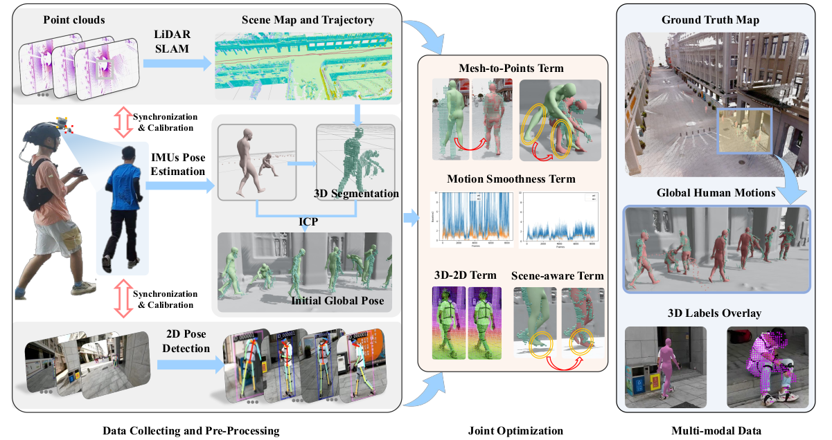
Pipeline
* SLOPER4D, Fig. 3

Slide 4
Acquisition: Sensors
128-beams Ouster-os1 LiDAR
On helmet
FoV = 360°×45°
Tilted down 45°
DJI-Action2
On helmet
FoV = 116°×84°
Data stored locally
PN studio mocap suit
Wireless IMU x 17
body limbs, torso, and head.
Intel NUC11 mini computer
Stores IMU data
Stores LiDAR data
24V battery
* http://www.lidarhumanmotion.net/images/sloper4d/1_hardware.mp4

Slide 5
Optimization: Annotation
RGB videos
4D point-cloud
2D skeleton (COCO)
3D skeleton (COCO)
SMPL parameters
IMU data for 17 points
Reconstructed 3D world map (Trimble TX5)
* http://www.lidarhumanmotion.net/images/sloper4d/1_data_intro.mp4

Slide 6
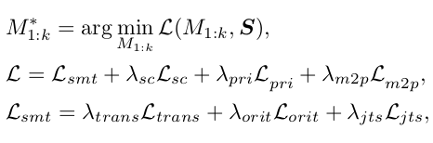
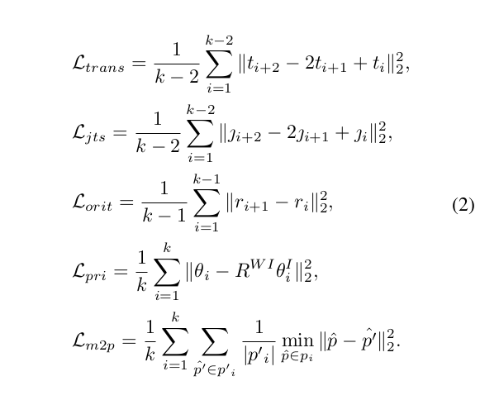
Optimization: Loss
Optimization of the human motion (M) in the given scene (S)
Using k frames of multi-modal data
Auxiliary smoothness loss
* SLOPER4D, Eq. 1, Eq. 2

Slide 7
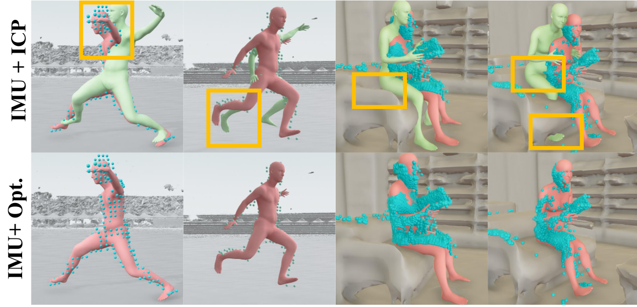
Optimization: Results (0)
Proposed (red) vs ICP (green) optimization
SMPL alignment qualitative comparison
* SLOPER4D, Fig. 5

Slide 8
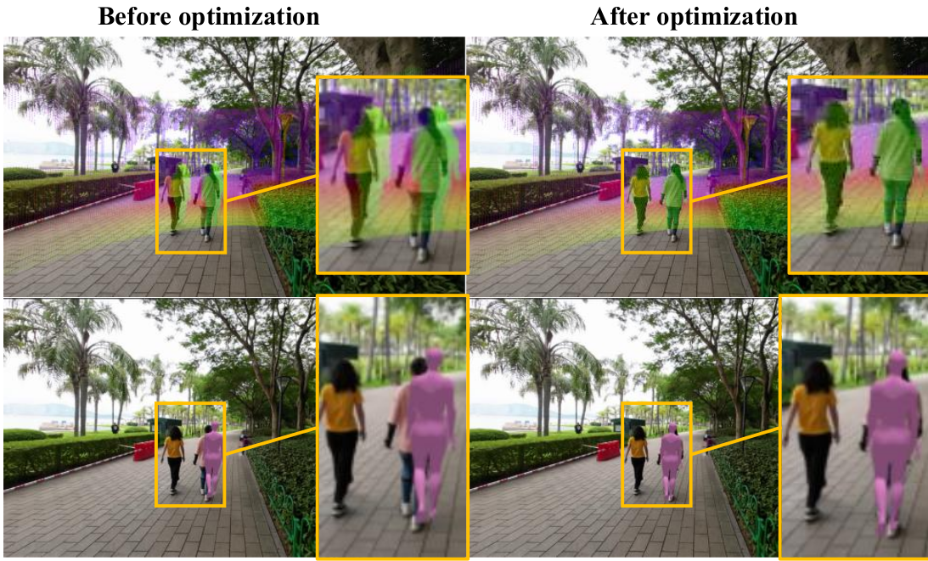
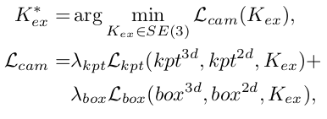
Optimization: Results (1)
Detectron model for 2D keypoints
Deepsort model for person tracking
IPNet and iPhone13 Promax 3D scan for SMPL shape parameters estimation
* SLOPER4D, Eq. 3, Fig. 6

Slide 9
Optimization: Results (2)
Proposed (red) vs ICP (green) optimization
* http://www.lidarhumanmotion.net/images/sloper4d/2_compare_202332215842.mp4

Slide 10
Optimization: Results (3)
Proposed (red) vs ICP (green) optimization
* http://www.lidarhumanmotion.net/images/sloper4d/2_compare_football_202332215855.mp4

Slide 11
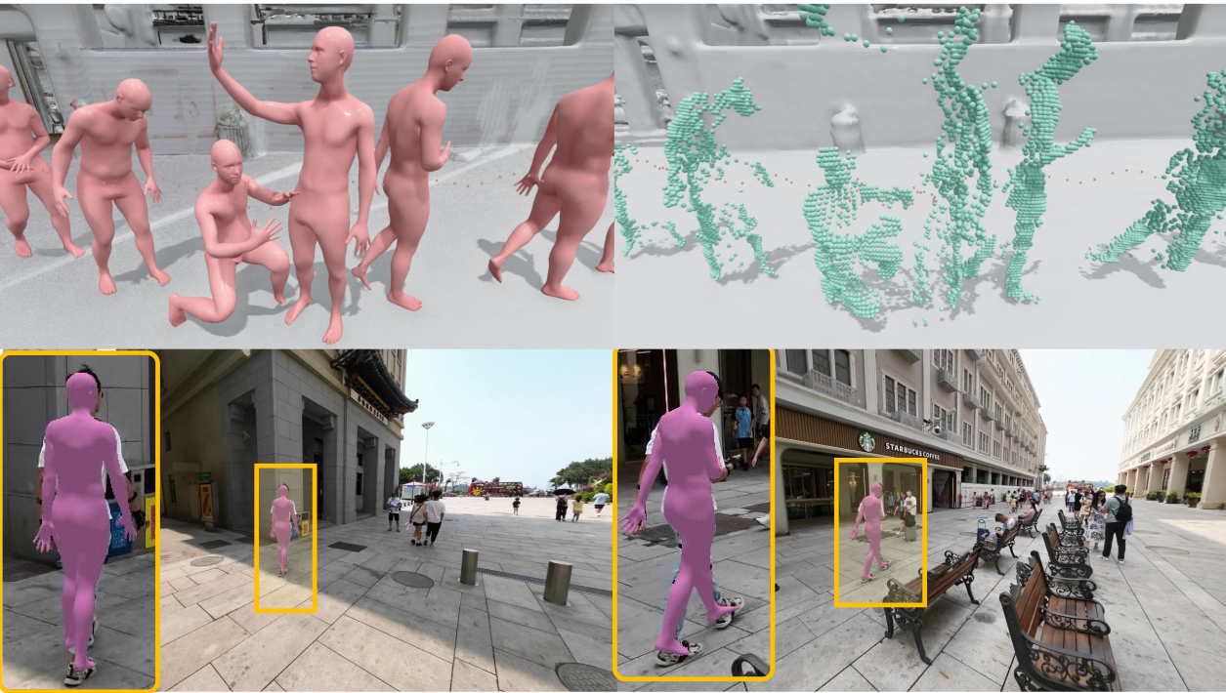
Evaluation: Qualitative (0)
Global Human Pose Estimation
Data acquisition
Data aggregation and optimization
* SLOPER4D, Fig. 4

Slide 12
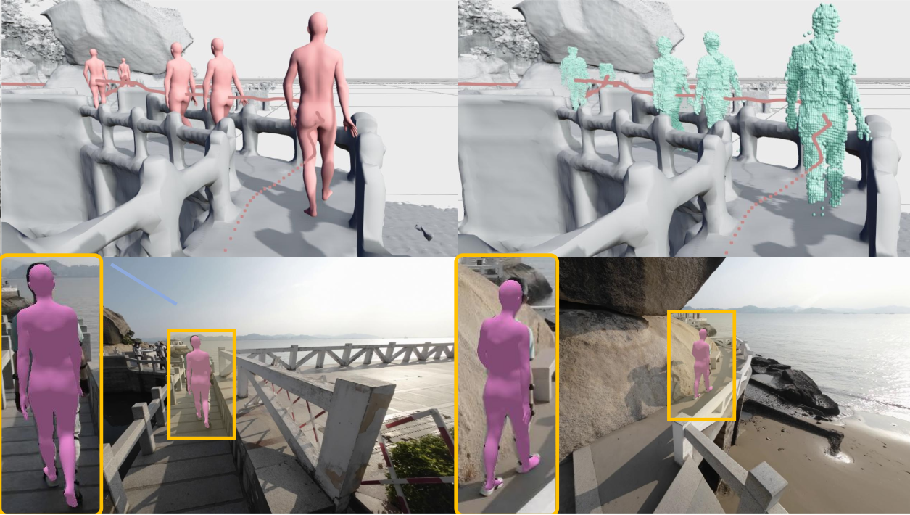
Evaluation: Qualitative (1)
Global Human Pose Estimation
Data acquisition
Data aggregation and optimization
* SLOPER4D, Fig. 4

Slide 13
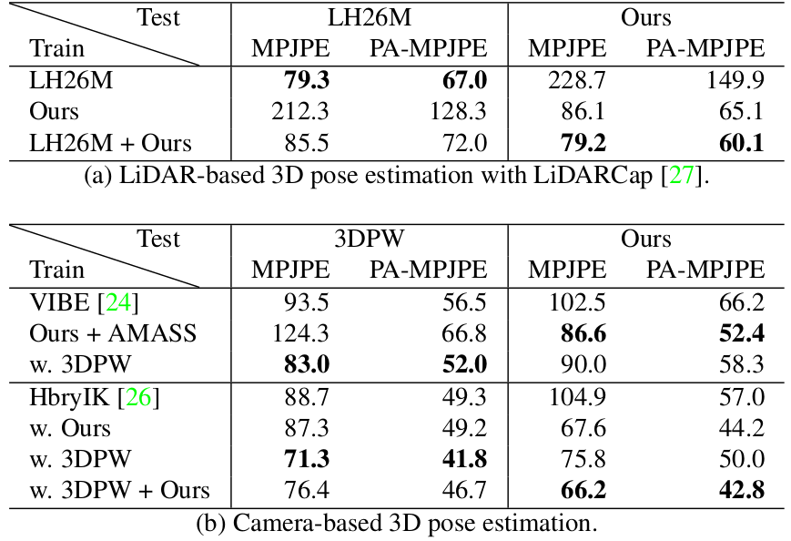
Evaluation: Quantitative results (0)
Mean per joint position error (MPJPE)
Procrustes-aligned MPJPE (PA-MPJPE)
* SLOPER4D, Tab. 2

Slide 14
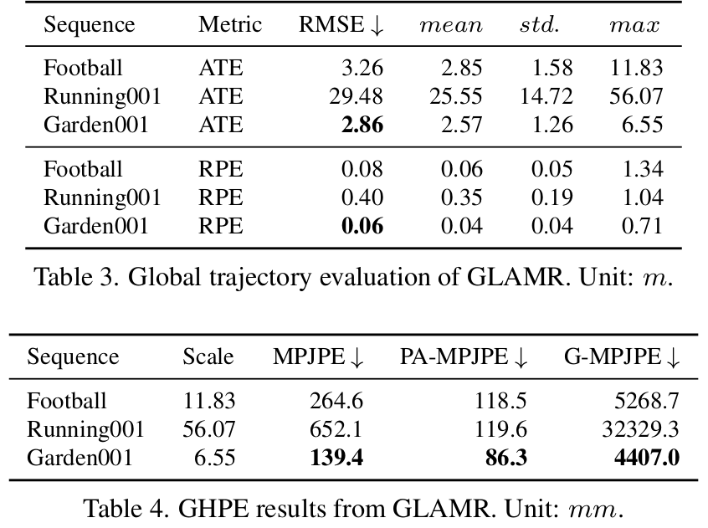
Evaluation: Quantitative results (1)
Absolute Trajectory Error (ATE)
Relative Pose Error (RPE)
Global
MPJPE (G-MPJPE)
* SLOPER4D, Tab. 3 and 4

Slide 15
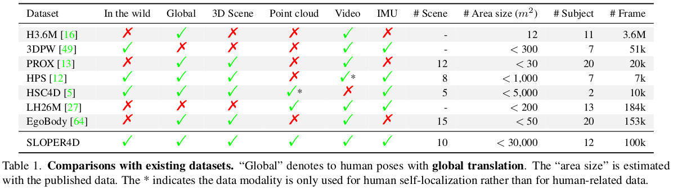
Conclusion: Comparison
* SLOPER4D, Tab. 1

Slide 16
Conclusion: Contributions
Global Human Pose Estimation (GHPE) dataset with the following modalities
RGB video
4D Point-cloud
17 point IMU data
2D and 3D pose estimation
SMPL model
Data available online
Processing pipeline available on Github
Accurate body shape estimation by pre-computing the SMPL shape parameters
Addition of the environment 3D mesh

Slide 17
Conclusion: Limitations
Lack of SMPL-X annotation
No support for multi-person GHPE
Offline and manual RGB/LiDAR synchronization
No use of colored point-cloud or mesh
Quantitative results are not focused on the accuracy of annotations
Lack of multi-view data introduces guess work in pose estimation of obstructed limbs
Use of old and inaccurate models for SMPL parameter prediction

